Slide 1
Optical chopper with 633 nm laser test
Morgan Blevins
Aug 30, 2024

Slide 2
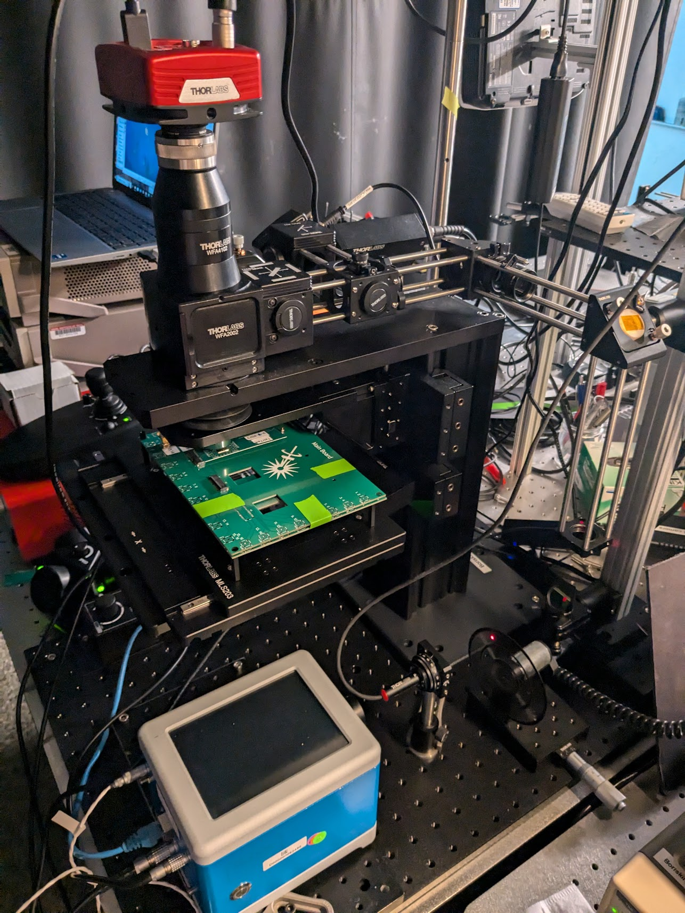
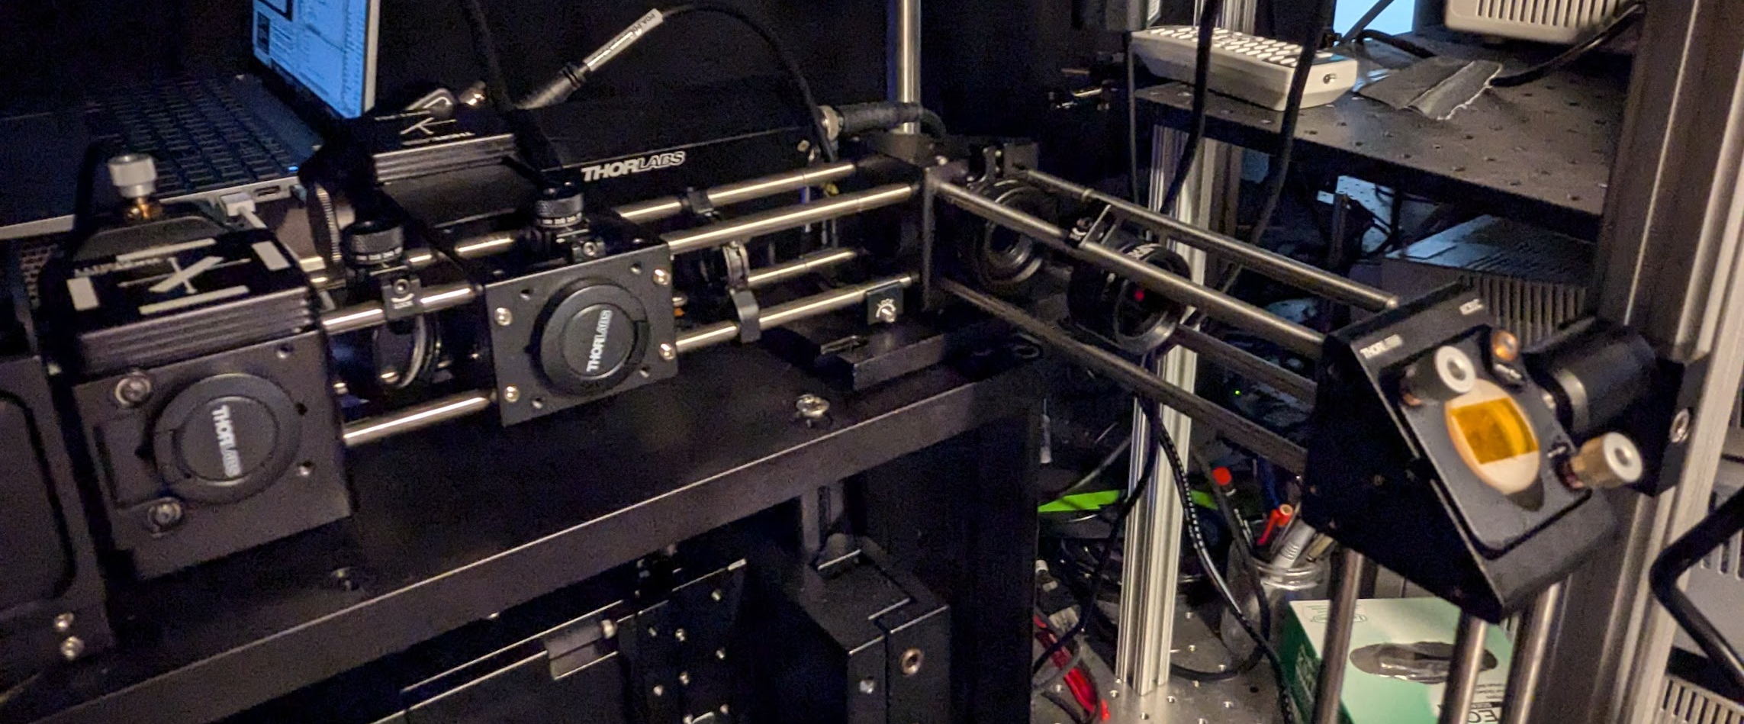
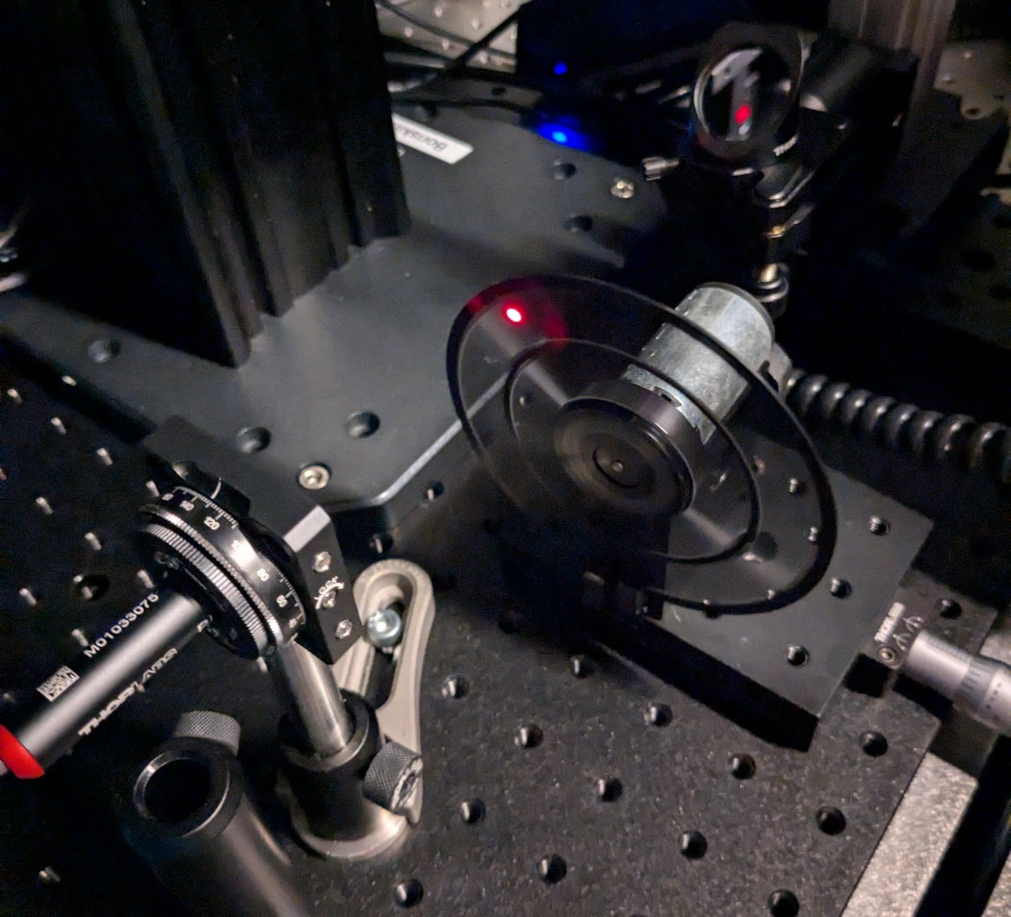
Beam compensator
iris
Mirror #3
Beam compensator
Mirror #3
iris
iris
Mirror #2
Beam splitter
30 ND filter
iris
Mirror #2
Beam splitter
Objective
Mirror #1
Chopper
Laser w/ 2-axis adjustable mount
Chopper
Laser w/ 2-axis adjustable mount

Slide 3
I followed the alignment procedure in the “alignment procedure” presentation
Very important to have alignment of the beamsplitter, compensator, and the objective and PMT.

Slide 4
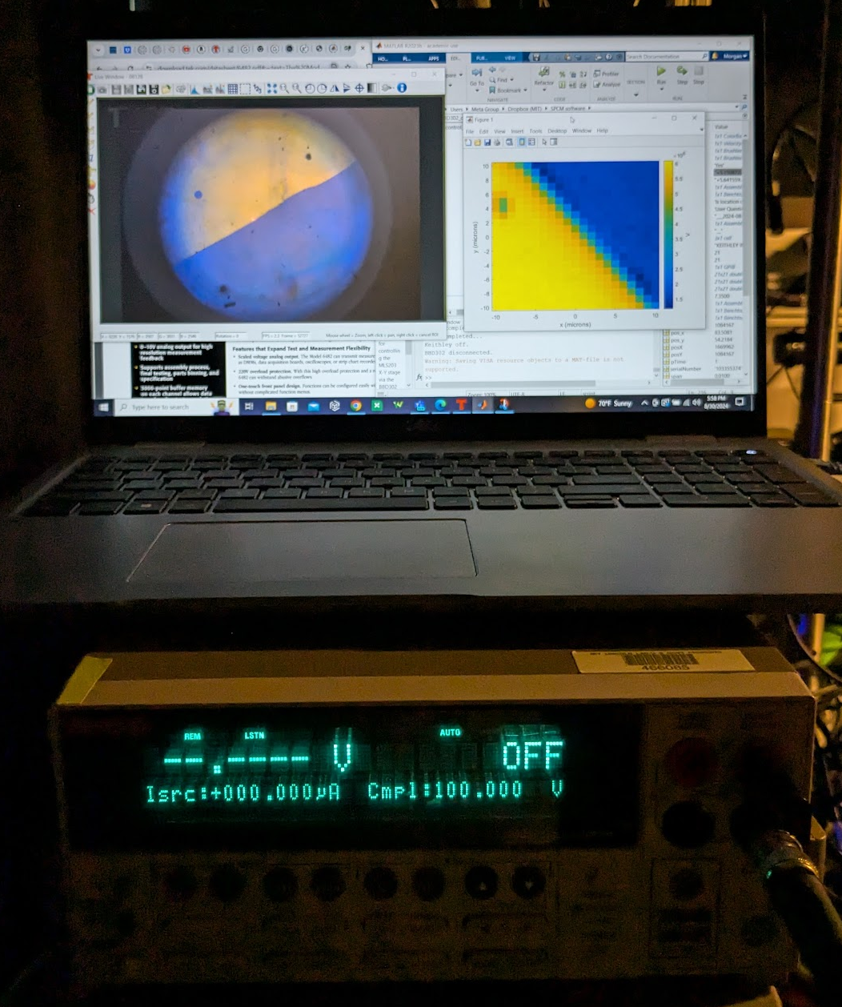
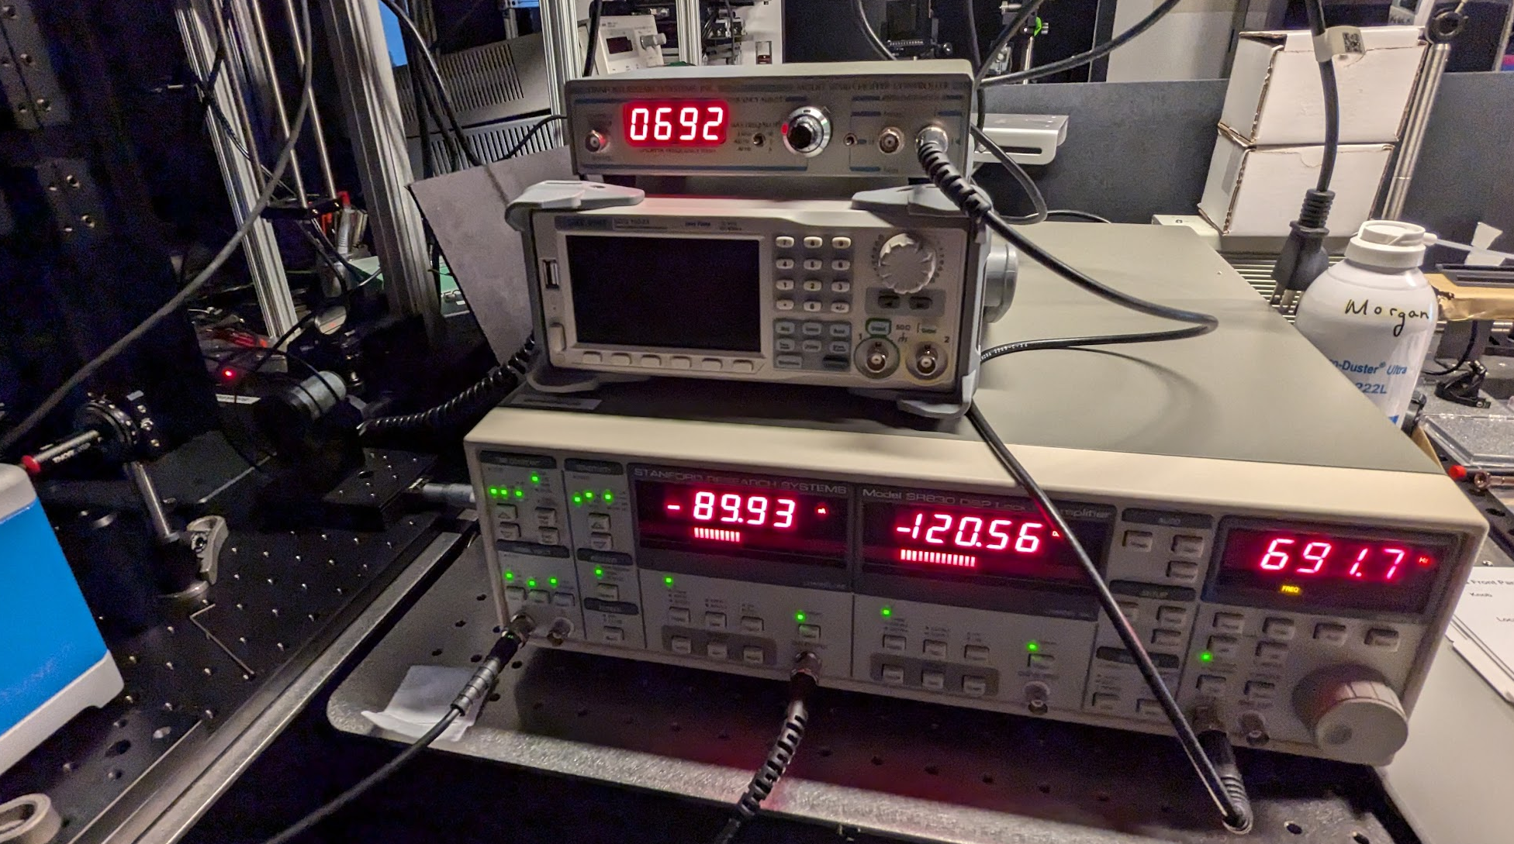
Position the chopper wheel in front of the laser such that the laser hits the outer slots
Connect the SR540 ‘f’ output to the the reference input of the SR830 Lock-in amp
Turn on the SR540 and set to desired frequency (avoid 60 Hz and its harmonics)
The SR830 lock in should immediately pick up the reference frequency and track is very easily
Connect the photodetector output to the SR830 input A and select current measurement
Set SR830 Channel 1 to display X or R (I did X in this test)
Set SR830 Channel 2 to display phase (theta)
Adjust setting of SR830 until Channel 2 phase is constant (follow 2f rule, etc)
Connect the Channel 1 output to the Keithley 2400 and perform a scanning map over a gold-silicon interface on a wafer
Stanford Research System SR540 Chopper Controller
Chopper Wheel
Photodetector output into lock-in
Lock-in output to Keithley 2400
Lock-in output to Keithely 2400
SR540 reference signal

Slide 5
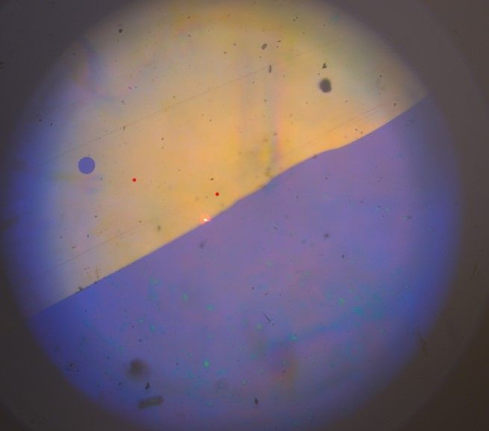
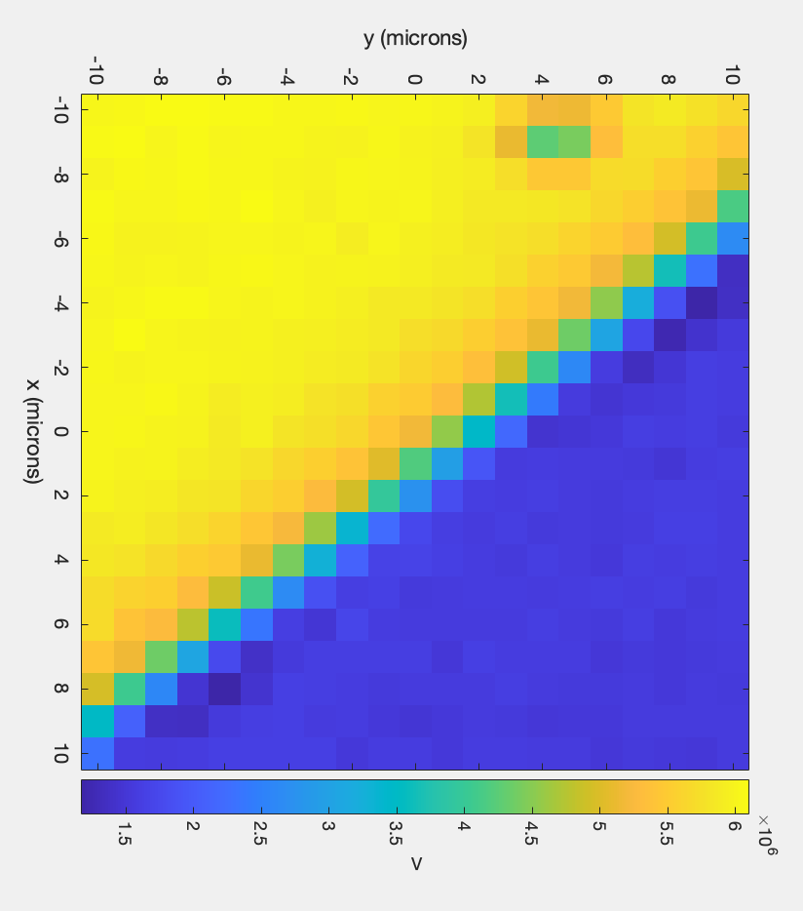
Square not drawn to exact size/location, just approx
This is the best reflection map I’ve ever gotten!! The gradation is really nice and exact. And it seems to even pick up a little hole in the upper right side.

Slide 6
Notes
The PMT gets saturated depending on the gain you use to power it, so it may show “overload” if the conditions are too bright in the room. Reduce gain or lower lighting
There is an extra 635 bandpass filter in Mathias’ cupboard- may add this in front of the PMT to get rid of this issue.
In this test I used a 30ND filter and had 1 small light on

